Slide 1


Social Buzz

Slide 2


Today's agenda
Project recap
Problem
The Analytics team
Process
Insights
Summary

Slide 3

Social Media Platform
Established in 2010 at San Francisco
500M Active monthly users
Need help to scale effectively
Project Recap

Slide 4

Problem
Over 100000 posts per day
36500000 pieces of content per year
Analysis to find Social Buzz’s top 5 most popular categories of content

Slide 5



Andrew Fleming
Chief Technology Architect
The Analytics team
Marcus Rompton
Senior Principal
Me – Shweta AT
Data Analyst

Slide 6
Process
1
Data Understanding
2
Data Cleaning
3
Data Modelling
4
Data Analysis
5
Uncover Insights

Slide 7

Insights
1897 reactions to Animal posts
Month with Most posts - January
16 Unique Categories

Slide 8
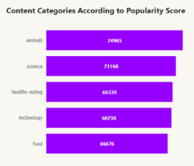
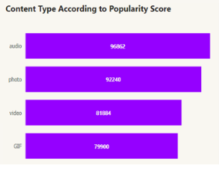

Slide 9
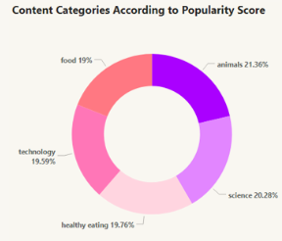

Slide 10

ANALYSIS
Animals and Science are the two most popular categories of content, indicating an innate tendency to seek connections with nature and facts.
INSIGHT
Food is a common theme with top 5 categories with ‘Healthy Eating’ ranking the highest. This may give an indication to the audience within your user base. Creating campaigns, working with influencers and brands that support healthy eating and healthy lifestyle can help to boost growth in these 2 categories.
Social Buzz can leverage holiday seasons to boost growth and the user engagement with food content category via relevant social media strategies.
Summary

Slide 11
NEXT STEP
Given the level of values obtained from this ad-hoc analysis, Social Buzz should allow Accenture to take this analysis into larger scale production for real-time understanding of the business.

Slide 12
Thank you!
ANY QUESTIONS?

